Slide 1



Slide 2

Space Finder: Smart Parking Lot Management system
Supervised by:
Dr. Muazzam Maqsood
Group Members:
Sidra Fayyaz (FA16-BSE-023)
Hifza Umer (FA16-BSE-043)
Department of Computer Science
COMSATS University Islamabad, Attock Campus

Slide 3
Outline
Introduction
Comparison table
Proposed Solution
Problem statement
Objectives
Requirement Specification
Methodology
Project Design
Modern tools
Benefits
References
_______________________________

Slide 4

Introduction
Automated Vehicle Detection and Assign Parking Area to their respective vehicle.
Our System will detect upcoming vehicle using CCTV camera and then automatically allocate space to them.
Record vehicle information taken from detection in database for assigning space to vehicle available in the parking lot.
User (Driver) will use our web based system to login itself first then will find parking space according to his/her vehicle type.
This will help user(driver) to find vacant space easily without wastage of time.
_______________________________

Slide 5
Applications And Comparison Table
Functionality | Space Finder (proposed Solution) | VCS(Vehicle counting system) | VDS(Vehicle Detection System) | SPARKU
Input from CCTV | ✔ | ✔ | ✔ | ✔
Detection | ✔ | ✖ | ✖ | ✖
Classification | ✔ | ✖ | ✔ | ✔
Payment | ✔ | ✖ | ✔ | ✖
Vehicle Count | ✔ | ✖ | ✖ | ✖
_______________________________

Slide 6
Problem statement
User( Driver) face issue of time-consumption during finding free space in parking area because many of vehicles are parked in parking areas randomly.
Parking owner not able to monitor their respective upcoming and out going driver in parking areas.
Sometimes security guard missed to keep the record of up coming and out going vehicles due to lot of vehicles are entering and exiting at a same time (parallelly)
_______________________________

Slide 7
Proposed Solution Save Space, Safe Space
In this Proposed Solution, we designed web based system for vehicle detection and allotting Parking Spaces.
In that Project, we used Yolov7 model for object detection and classification based on height and width of each vehicle and create bounding box on detected object.
Also created bounding box on free spaces by fixing height and width of bounding box.
_______________________________

Slide 8
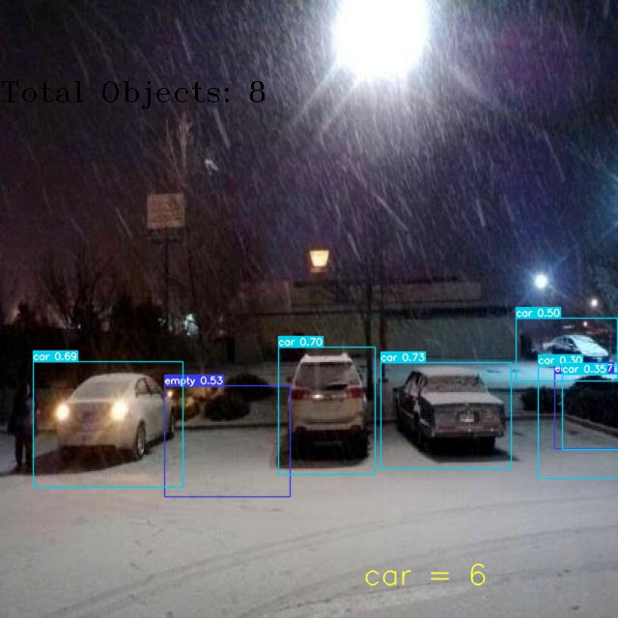
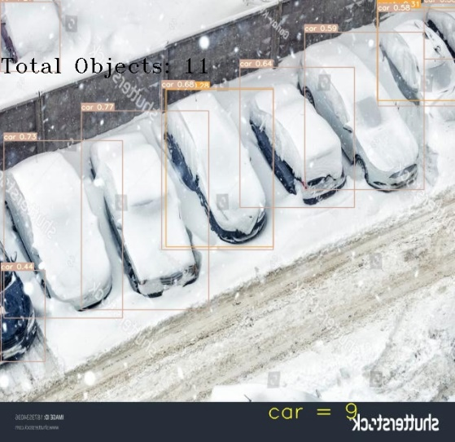
Proposed Solution
Results on Different Weather Conditions
Testing on Night Footage
Testing on Foggy Image
_______________________________

Slide 9
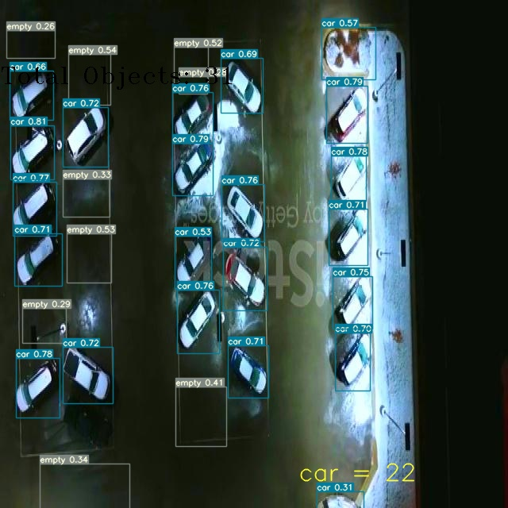
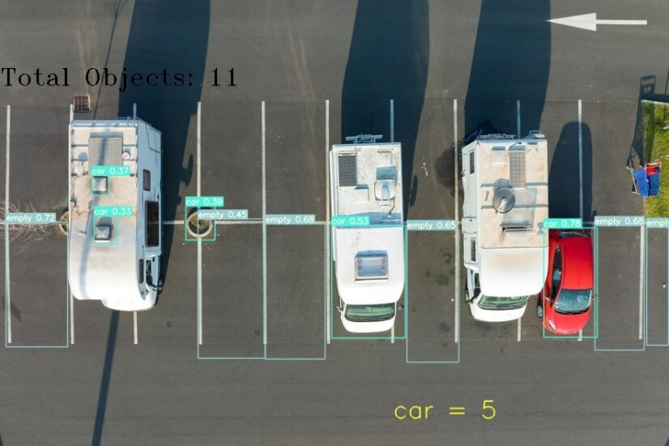
Results on Different Weather Conditions
Testing on Day Footage
Testing on Rain Footage

Slide 10
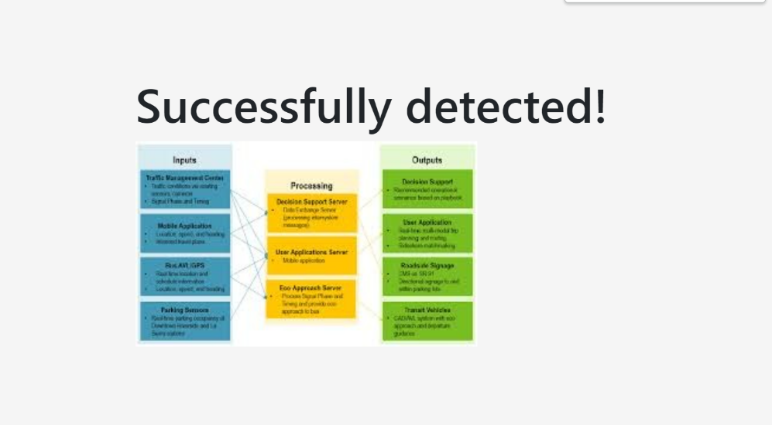

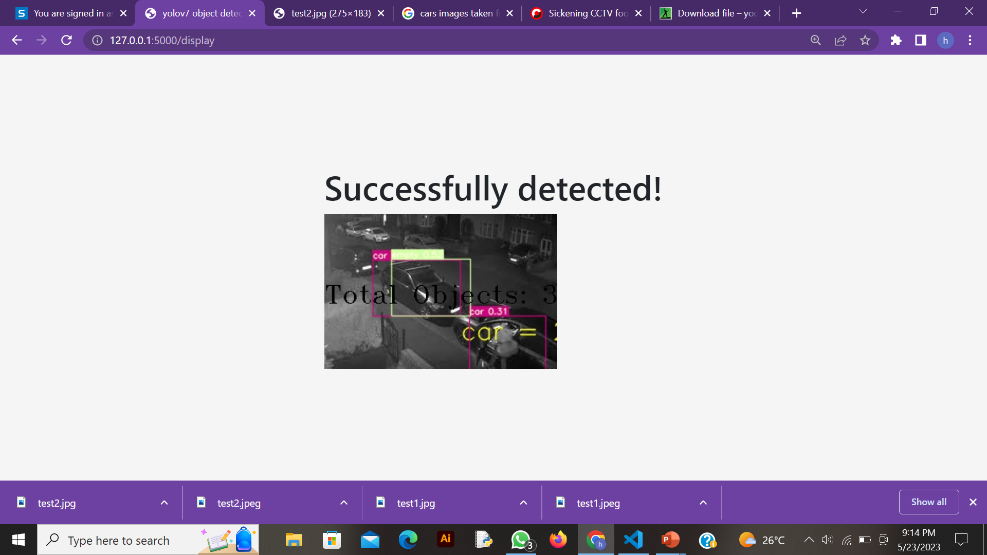

Results on Unknown Images

Slide 11
Objectives
Automated Parking allocated system for Drivers.
Automated capture and detect vehicles using system from CCTV.
To increase the effectiveness of the utilization of CCTV cameras by employing them as the project's primary input source.
To save faculty and staff at the institution time and money.
To assist the university community in overcoming this pointless annoyance brought on by the parking issue.to advance our understanding of computer vision.
_______________________________

Slide 12
Requirement Specification
To build this application, one must have system with following specifications
At least 6th-7th generation
At least core i3
GPU
At-least 8GB RAM
SSD
_______________________________

Slide 13
Functional Requirements
FR-01 Detect and Classify Vehicle
FR-02 Detect Empty Slots
FR-03 CRUD Operation on database
FR-04 Update the database
FR-05 Payment
FR-06 Input from CCTV
_______________________________

Slide 14
Non Functional Requirements
NFR-01 User Friendly
NFR-02 Responsive
NFR-03 Fully Automated System
NFR-4 Cost Effective
NFR-5 Robustness
_______________________________

Slide 15
Development Requirements
Software Requirements dependence:
IDE: Colab, Python IDLE
Programming language:Python,HTML5,CSS3, JavaScript
Database: SQLite
Hardware Requirements dependence:
Smart Mobile Phone
Internet
Cameras

Slide 16
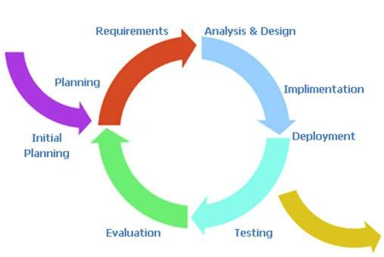
Rationale behind Selected Methodology
Incremental/ Scrum Model is used in the development of this application because requirements of software are first broken down into several modules that can be incrementally designed, implemented, and tested. The plan is made just for the next increment and not for any kind of long-term plans. Therefore, it is easier to modify.
_______________________________

Slide 17
Project Design
Project design is an important part for developing a graphical view of requirement based on the detailed functional and non-functional requirements.
Project design is only acceptable and marked as good after understanding the requirements of the project provided for development.
It is always good practice to start from making a high-level design and then move it to low-level design phases.
_______________________________

Slide 18
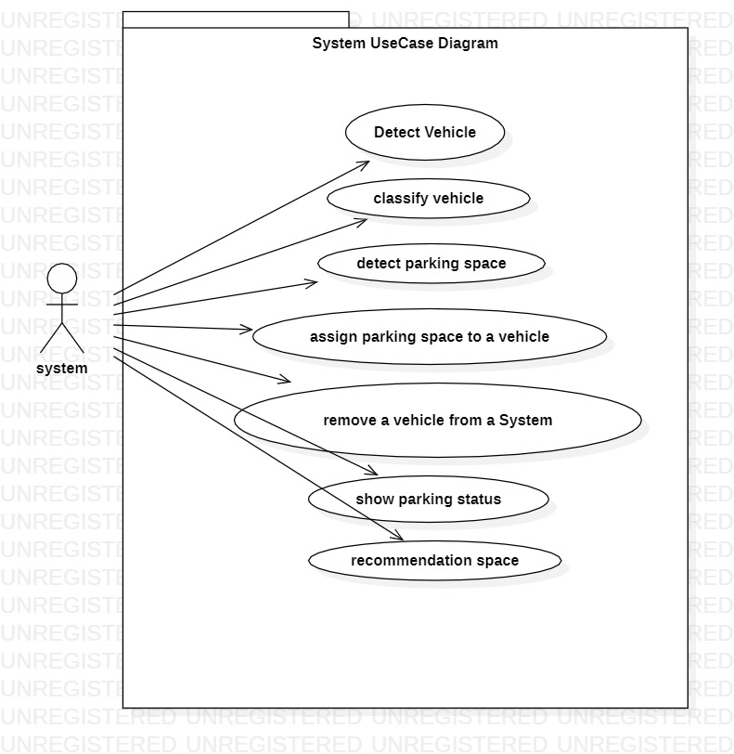
System Use Case Design
_______________________________

Slide 19
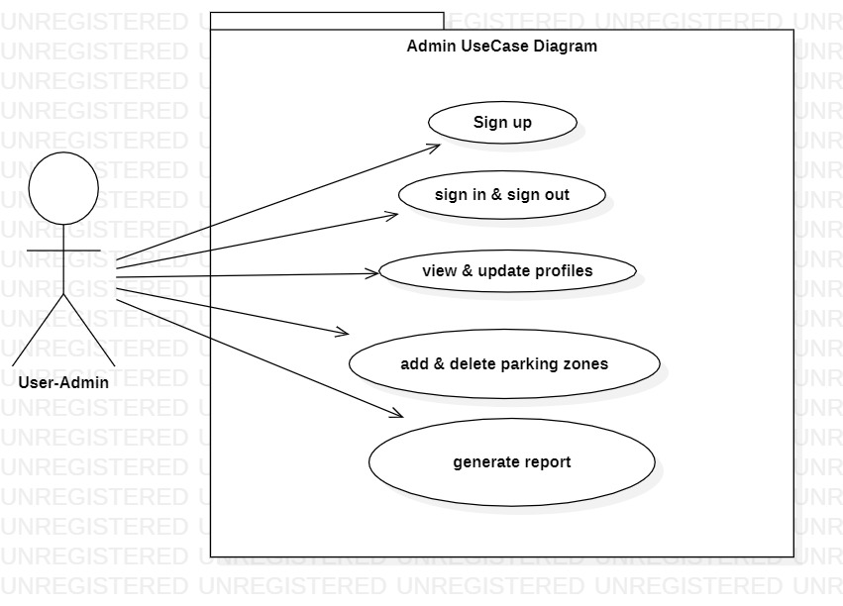
Admin Use Case Diagram
_______________________________

Slide 20
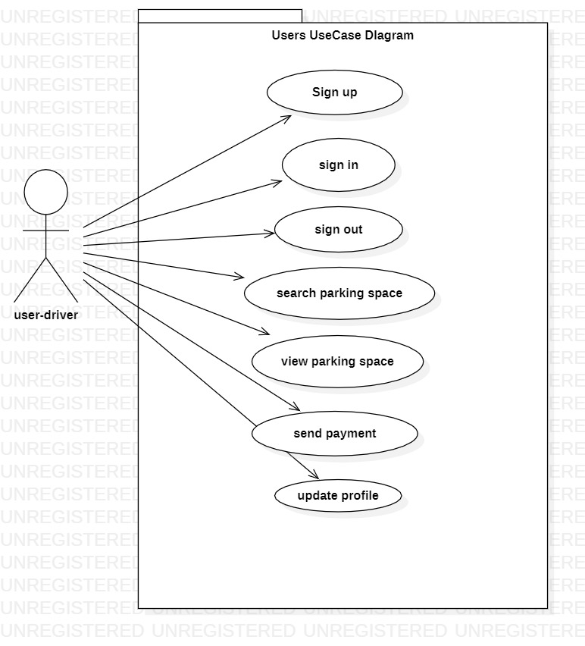
User Use Case Diagram
_______________________________

Slide 21
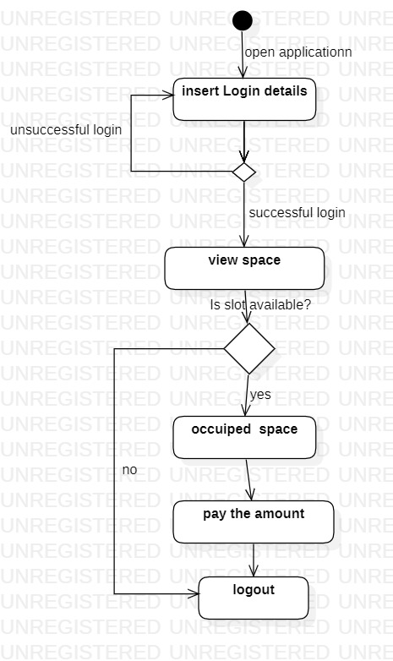
User Activity Diagram
_______________________________

Slide 22
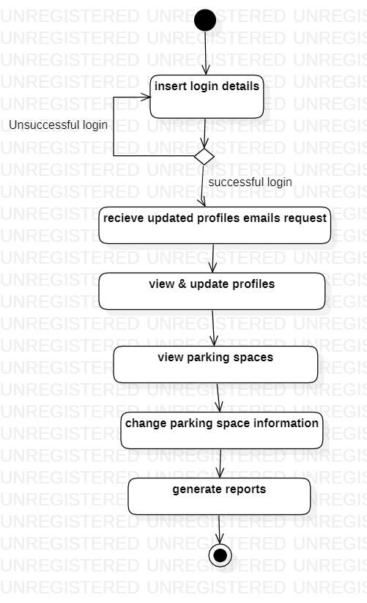
Admin Activity Diagram
_______________________________

Slide 23
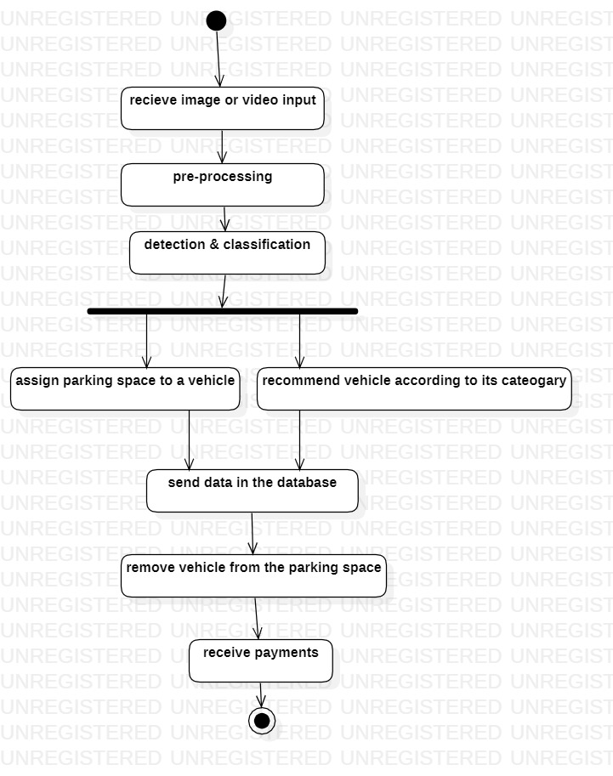
System Activity Diagram
_______________________________

Slide 24
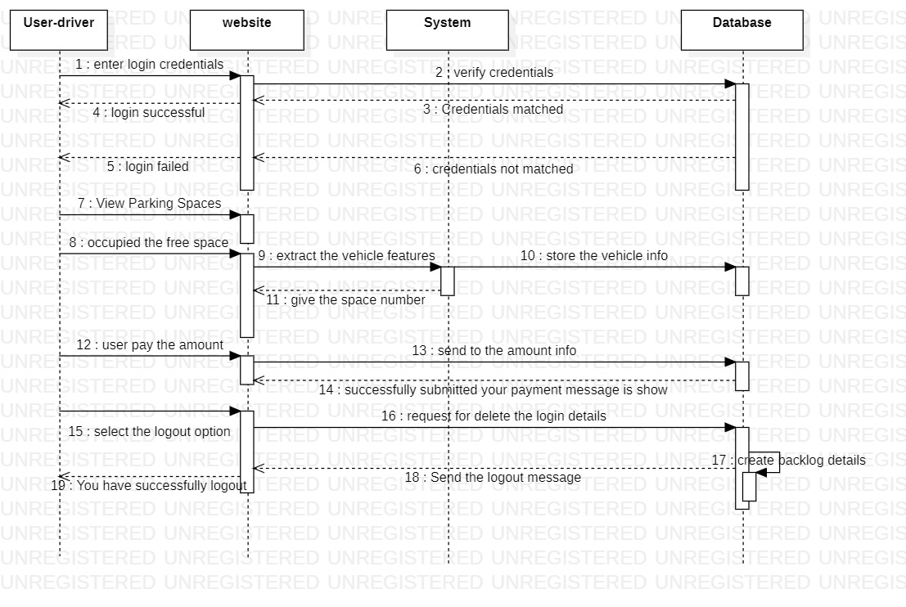
User Sequence Diagram
_______________________________

Slide 25
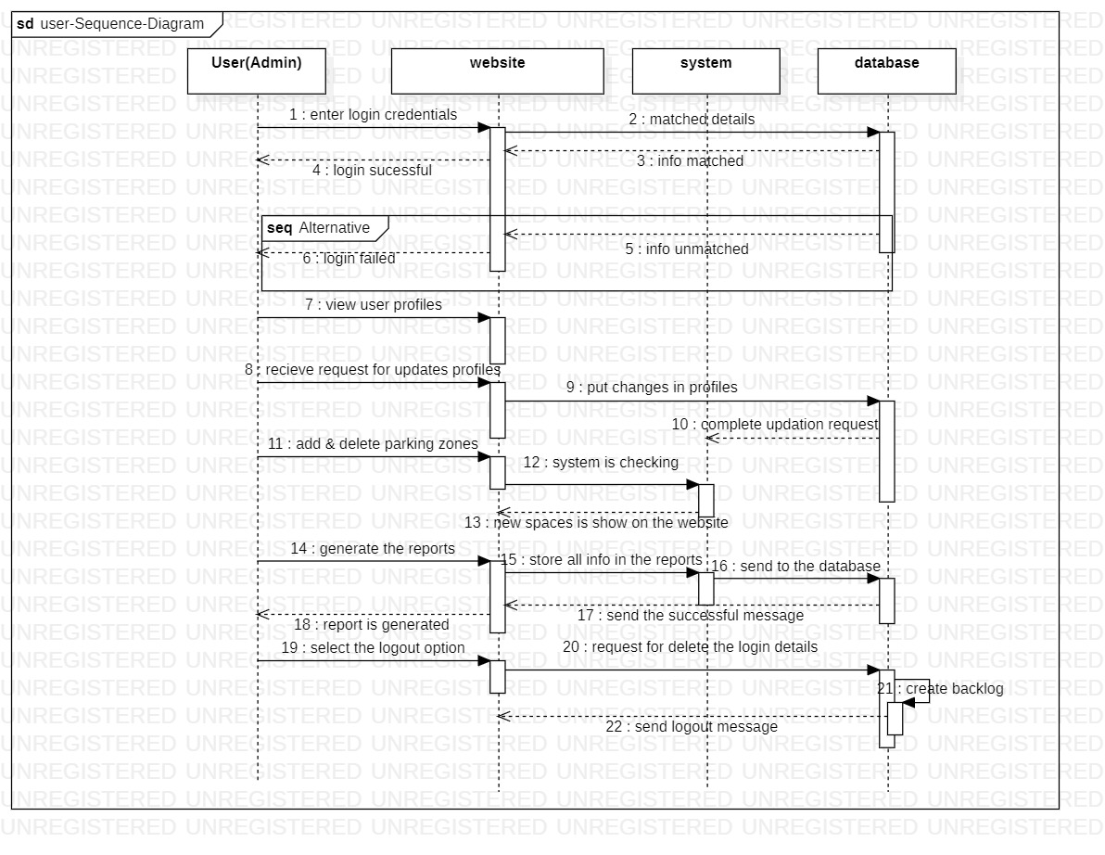
Admin Sequence Diagram
_______________________________

Slide 26
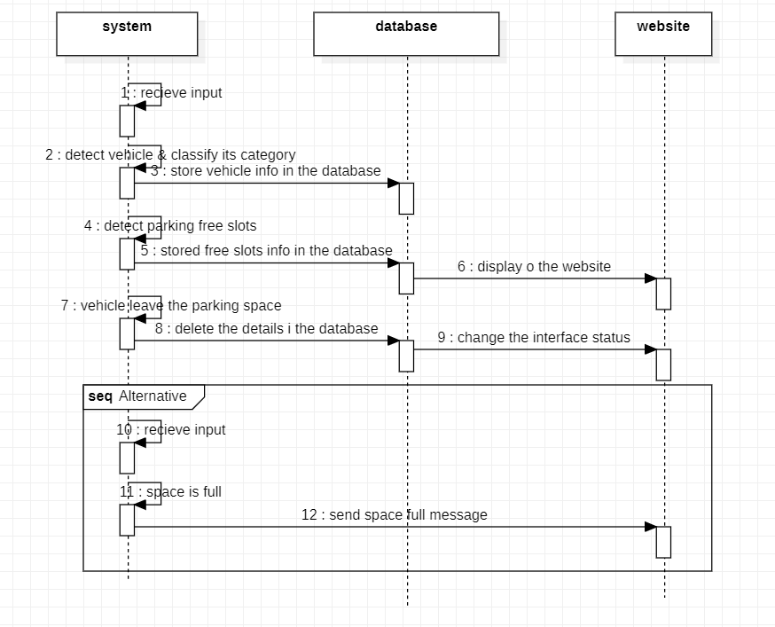
System Sequence Diagram
_______________________________

Slide 27
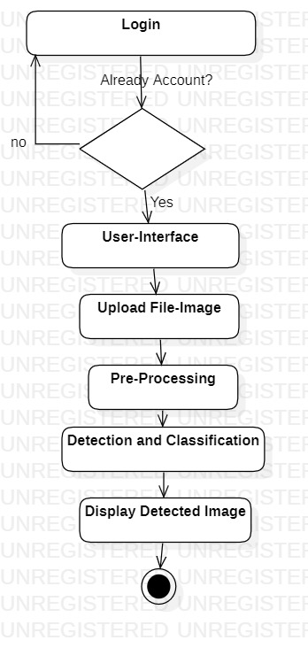
System Architecture
_______________________________

Slide 28
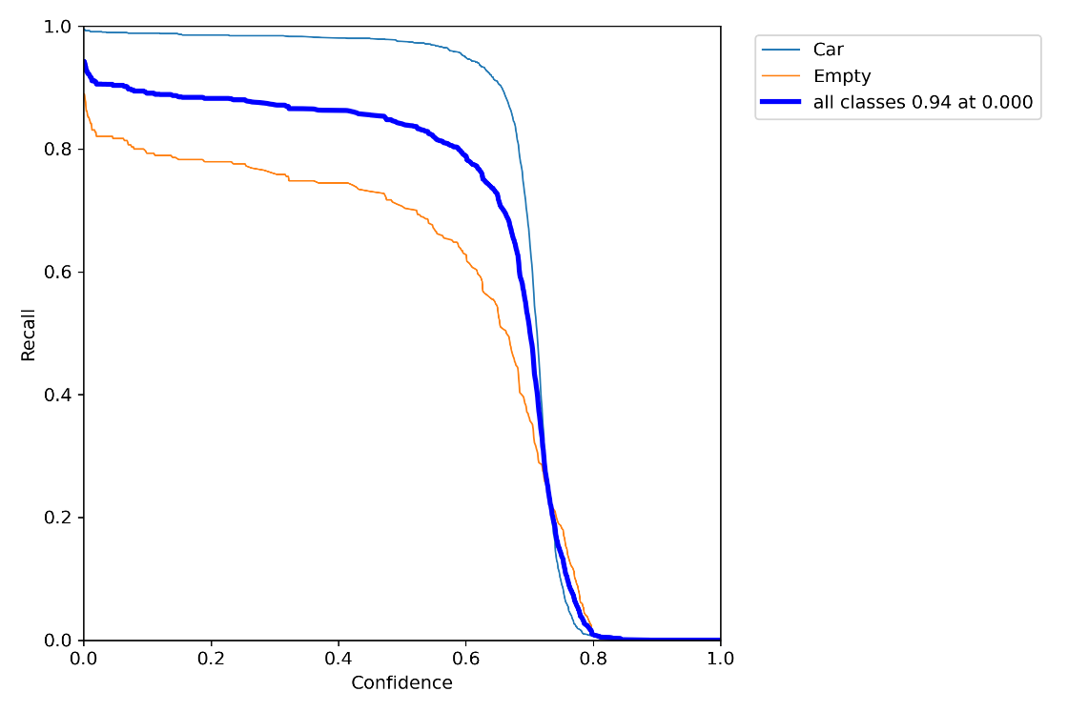
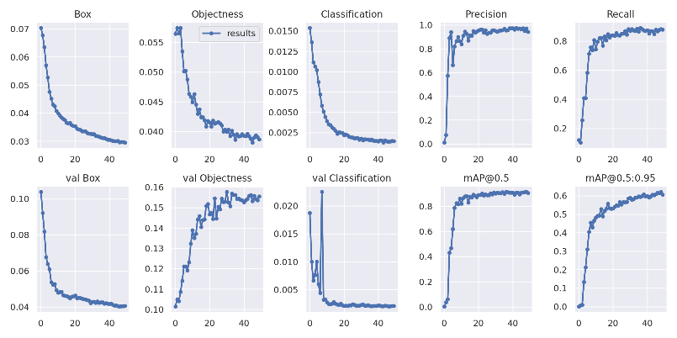
End Results of Model
Overall result
Recall result

Slide 29
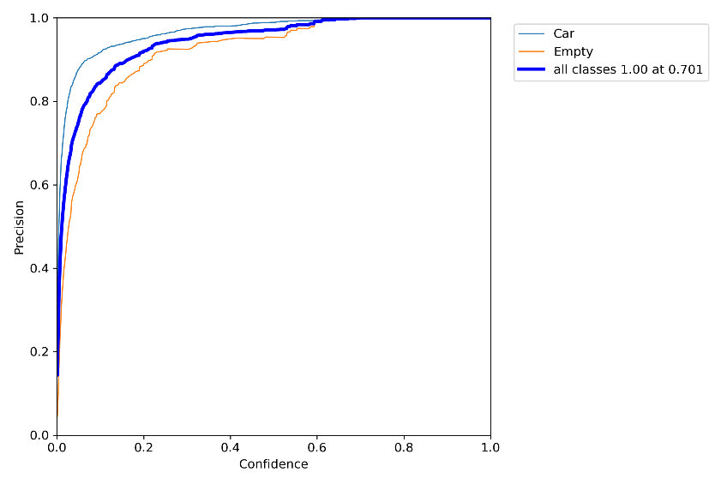
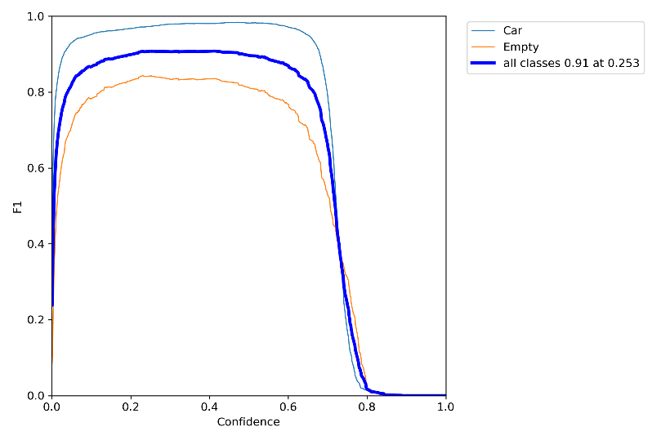
End Results
Fi-Score
Precision Result

Slide 30
Modern tools
Tools | Rationale
MS Word | Documentation
MS Power Point | Presenatation
Star UML | Designing and Modeling
Flask | Framework
HTML5 , CSS3, JavaScript | Frontend Development
Python | Backend Development
SQLite | Database
_______________________________

Slide 31
Benefits
Fast Computational time.
Less prone to human error.
Robust and flexible to large data amount.
Compare Accuracy Results with other techniques.
Cost effective
_______________________________

Slide 32
References
Referenced Links:
https://www.kaggle.com/shawon10/object-detection-from-a-trafficvideo/data?select=road_trafifc.mp4
https://www.pexels.com/video/traffic-flow-in-the-highway2103099/
https://www.pexels.com/video/different-kinds-of-vehicles-on-thefreeway-2053100
_______________________________

Slide 33
Any Question ?

